Slide 1

From Supplier to Partner
奧隆精密股份有限公司
WE ARE YOUR GOOD PARTNER
LONG TERM BUSINESS PARTNER

Slide 2
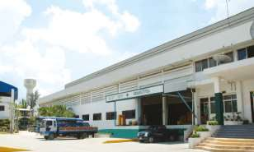


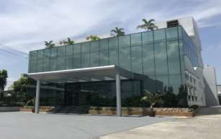

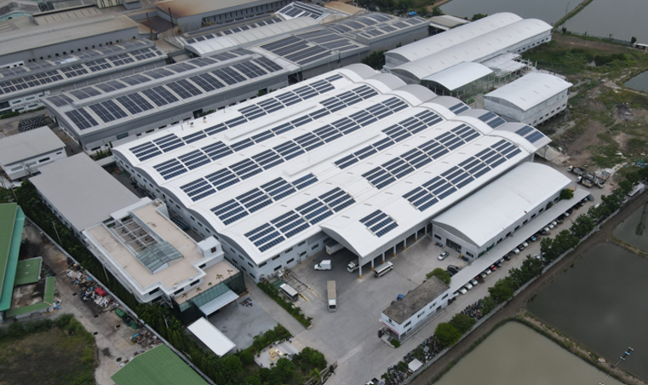
Aurum History
Civica (Thailand) Co.,LTD.
1991
1996
Central Plating Industry Co., LTD. (CTP)
ISO 9001 : 2000
ISO/TS 16949 : 2002
2005
2008
Electronic Assembly production line
ISO 14000
2009
2011
Jumpway Co., LTD.
Aurum Electronic Co., LTD.
Looking for EMS customer and Automotive and new market .
2019

Slide 3
Supplier Summary - Aurum
Vendor Basic Information
Supplier Name Factory location
Head count Capacity
Machine Tonnage
Aurum Electronics Co. Ltd
Thailand
300
123 Stamping, 4 Punching, 2 Laser Cutting & 9 Bending & 23 Injection Machines
25T - 400T
Key Technology
Main Process
Secondary Operation
Sheet metal - Soft tool / Hard tool, Injection Molding, Machining
Prototyping
Machining Process
Painting / Powder coating lines
Assembly Process
Engineering
DFM Tooling Design NCT Stamping
Quality System
ISO 9001:2015
ISO14001: 2015
IATF 16949:2016

Slide 4
Capability Matrix
Company overview
Management
Commitment
Quality & Certification
Technology
Product Experience
Commercial
• Close proximity
Thailand site
• Financially stable
• Scalable model
• Quality Certification
• 300 Manpower
• >10 years
Relationship
Effective decision making
• Commitment
• Communication
style
• ISO 9001:2015
• ISO 14001:2015
IATF 16949:2016
ISO 13485: 2016
• Prototyping
• Sheet metal
NCT / Stamping
• Injection Molding
Machining Process
• Powder coating
• Assembly Process
• Power supply
& Telecom
• Metal parts
• Plastic parts
Stamp parts
Busbar
Chassis assembly
Cabinet assembly
Lighting assembly
• Cost Solution
• Preferable T&C

Slide 5
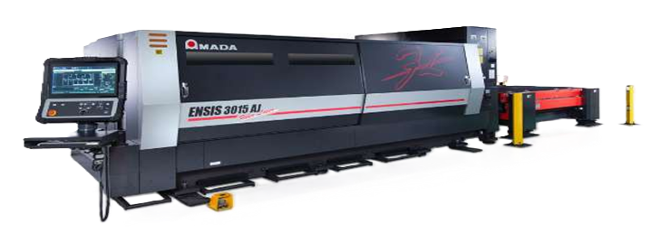
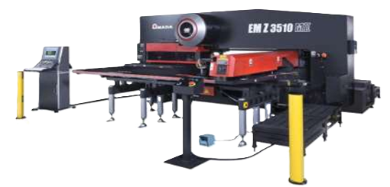
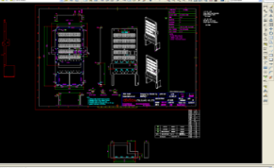
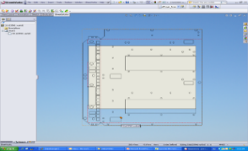
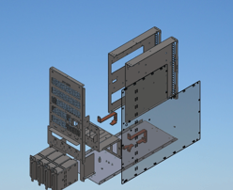
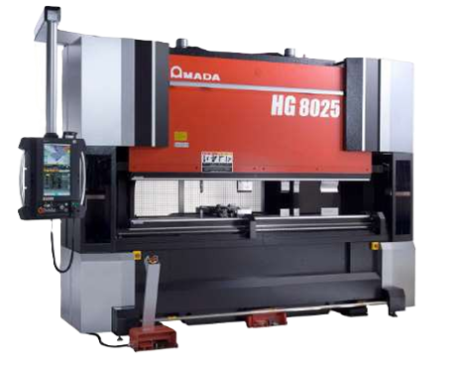
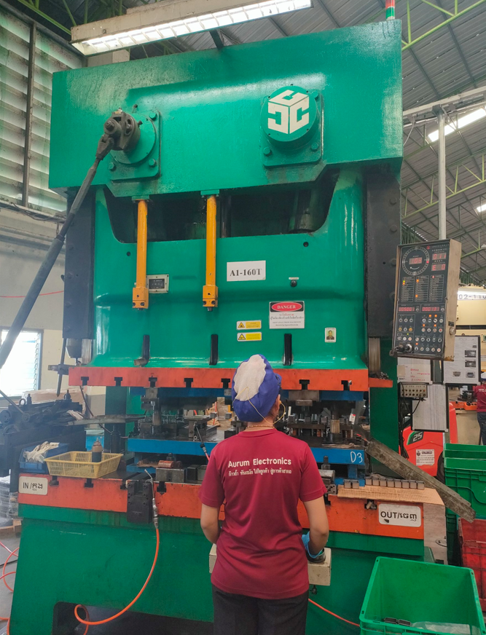
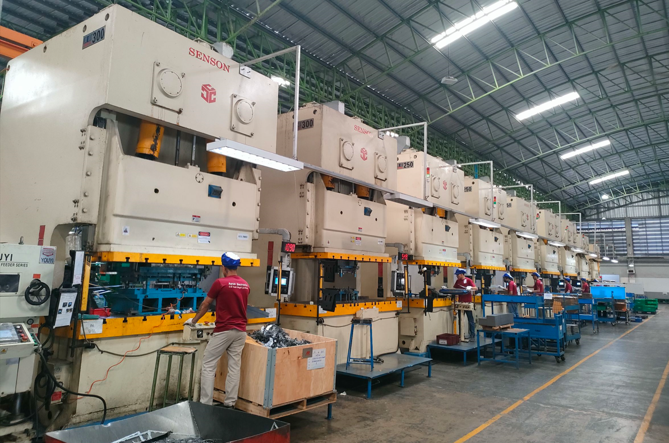
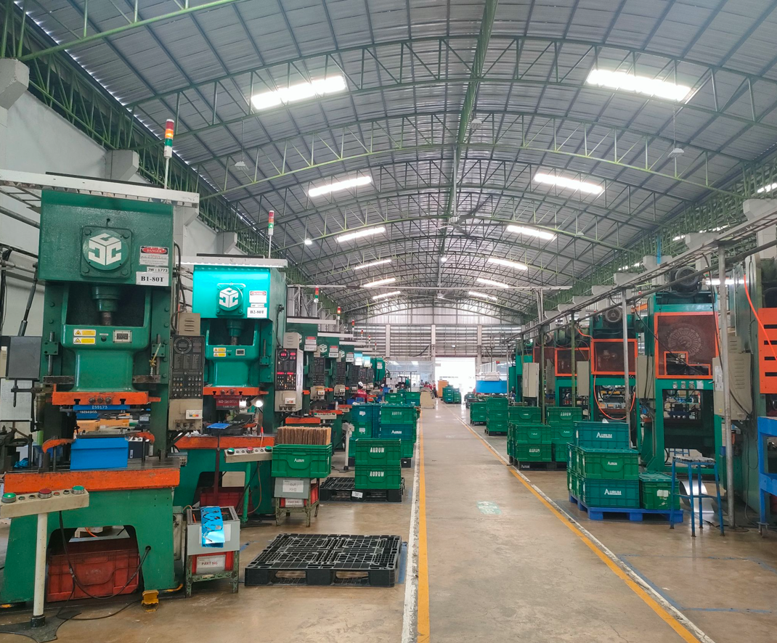
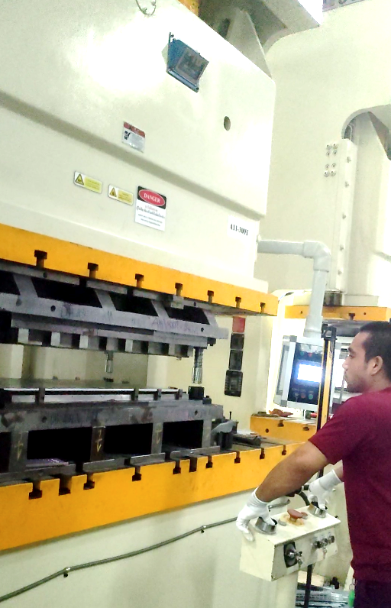
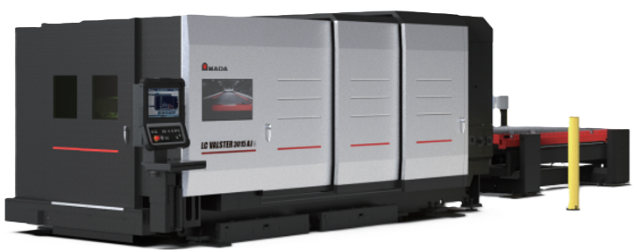
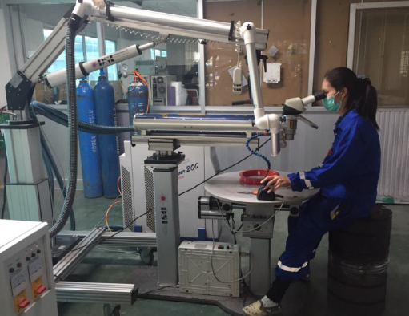
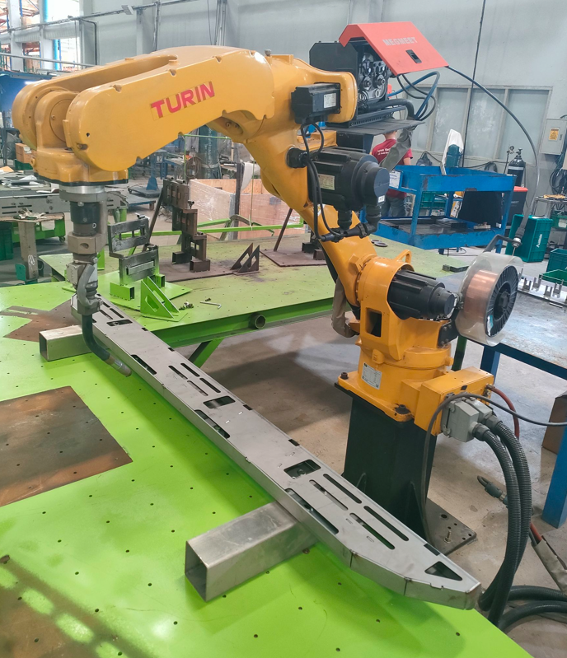
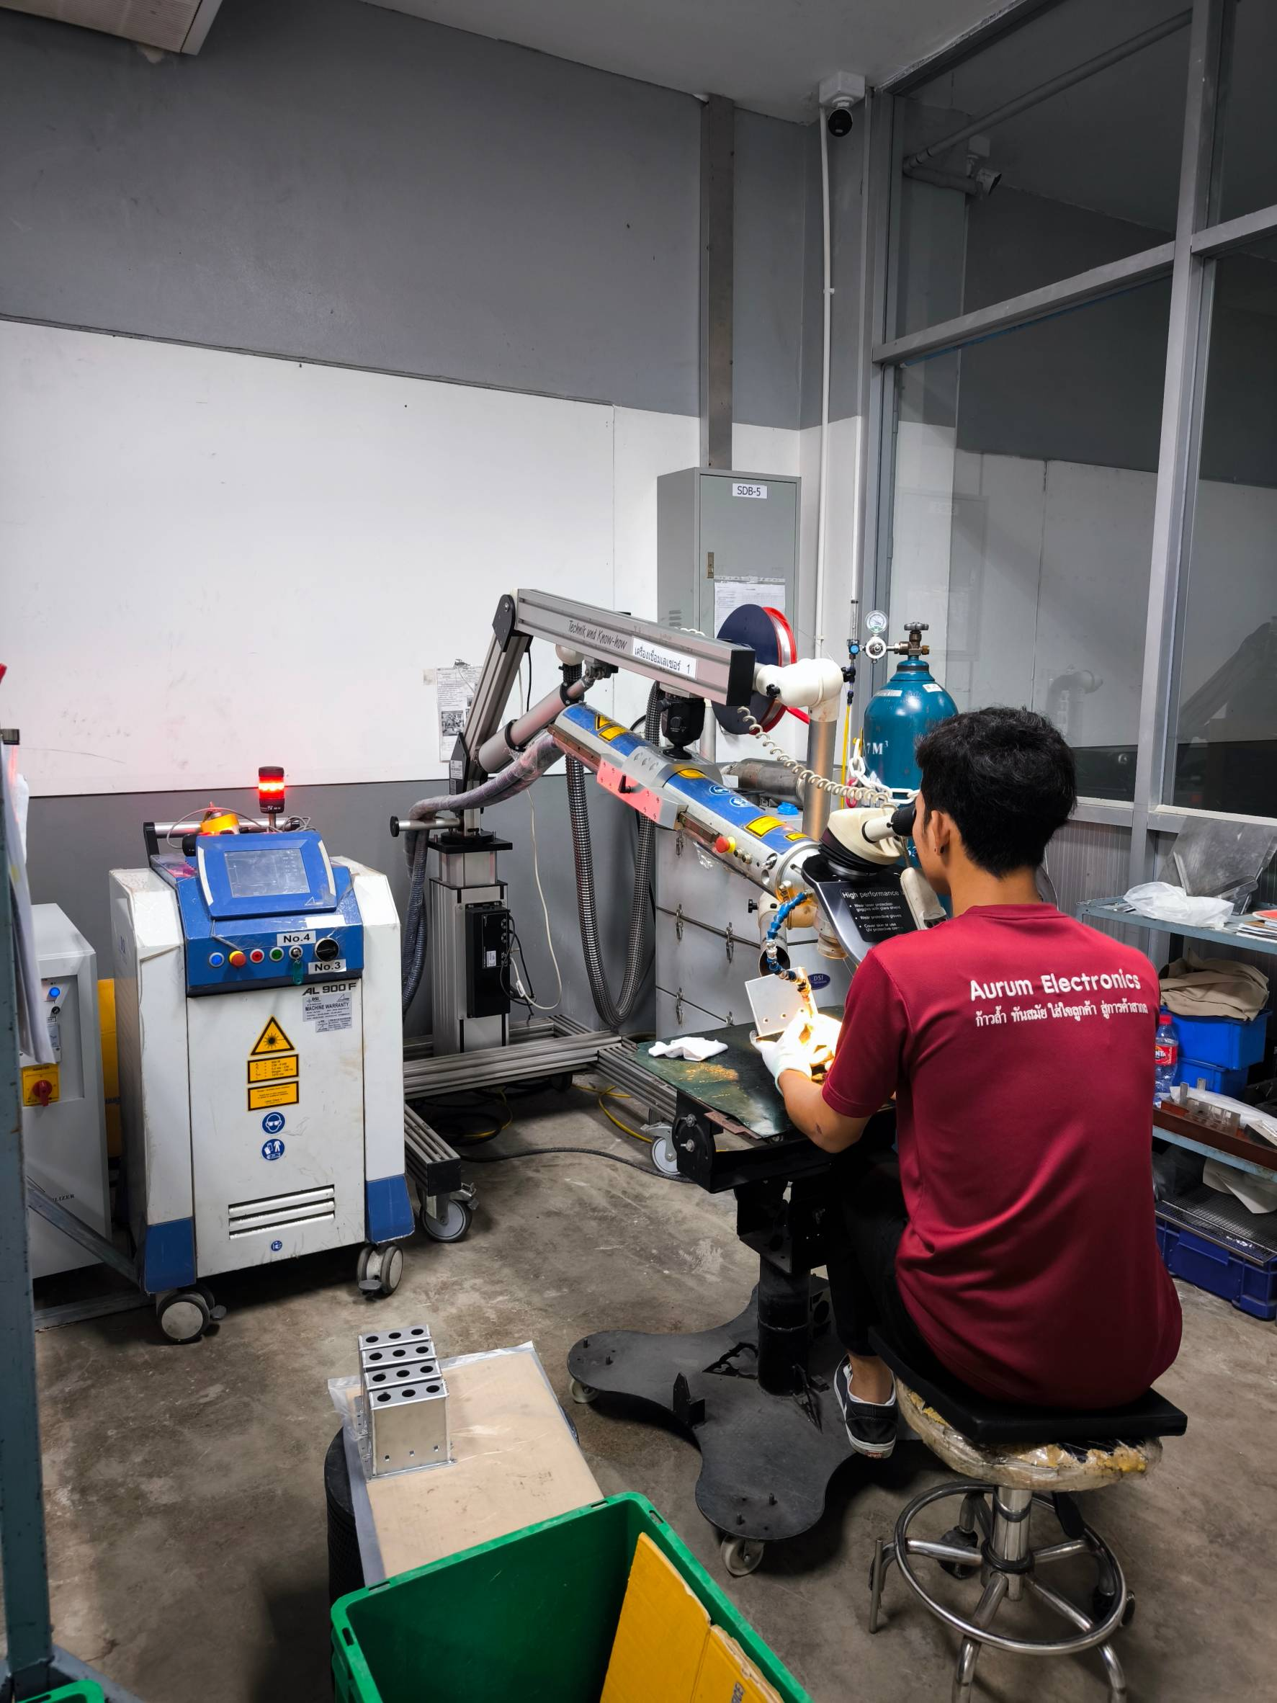
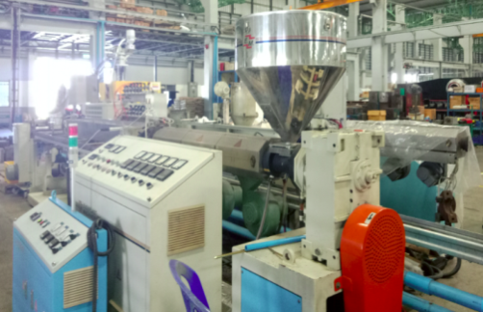
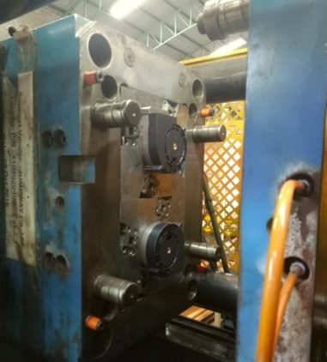
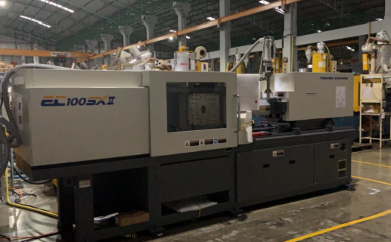
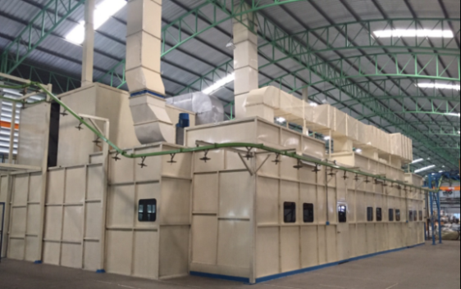
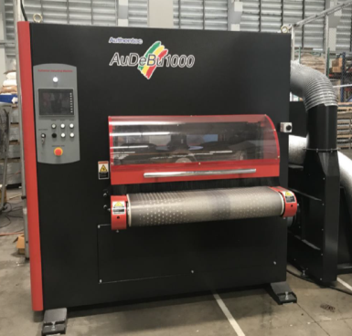
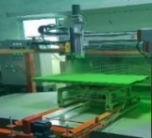
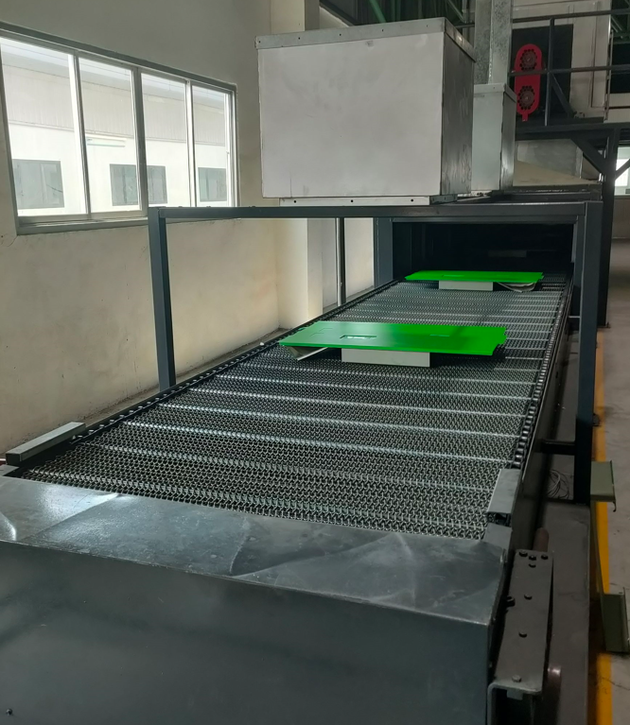
Overall Process Capability
Mechanical Design Capability Tooling design (Stamping). DFM (Design For Manufacturability) Program/Software used Solidworks/ AutoCad / Sheetworks / AP100 / MasterCam / BendCam | NCT Short lead time & low cost (Tooling). LT 7-45 working days Use for prototype, medium or low volume production. Disadvantage, short life cycle (Tooling) & difficult to maintain tight tolerance. | Stamping Long life cycle (Tooling) LT 45-90 working days depending on the complexity of the part design. Capable to process parts with tight tolerance. For high precision parts and high volume. Disadvantage, high cost tooling & longer lead time.
Plastic Injection, Machining & 3D Printing Automatic equipment: Injection Molding with Robotic Arms to increase production efficiency and maintain stable quality. LT 20-90 working days depending on the complexity of the part design. | Metal Joints 16 Welding Machines (3 Laser Welding , 4 TIG, 4 MIG & 5 Spot Welding) | Secondary & Other processes Painting / Powder Coating (Wagner) Plating (Central Plating Industry Co., Ltd.) Curing Oven (Wire Hanger & Conveyor) Buffing / Deburring Machine (AuDeBu1000) Silkscreen & Laser marking

Slide 6
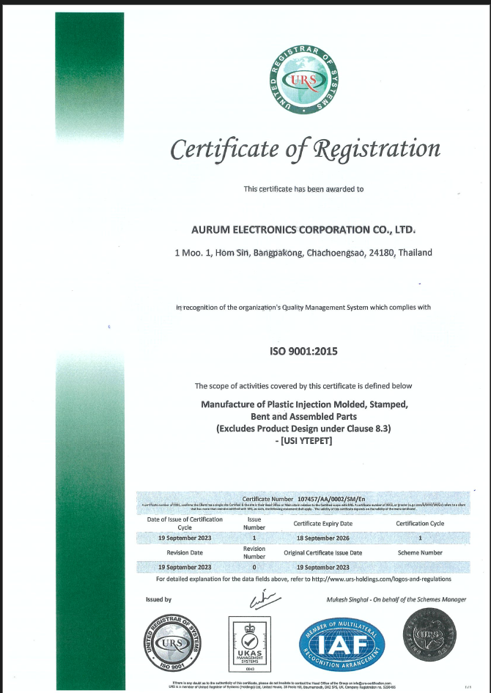
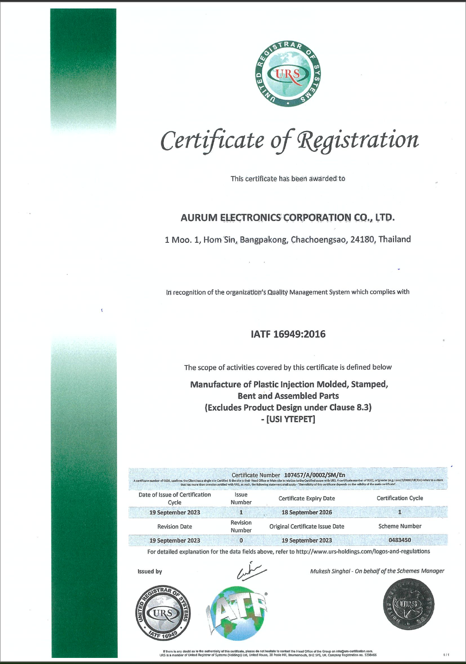
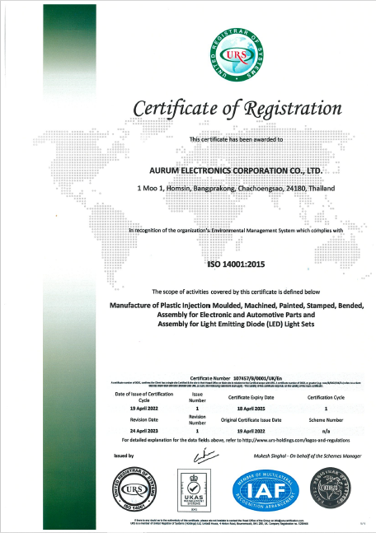
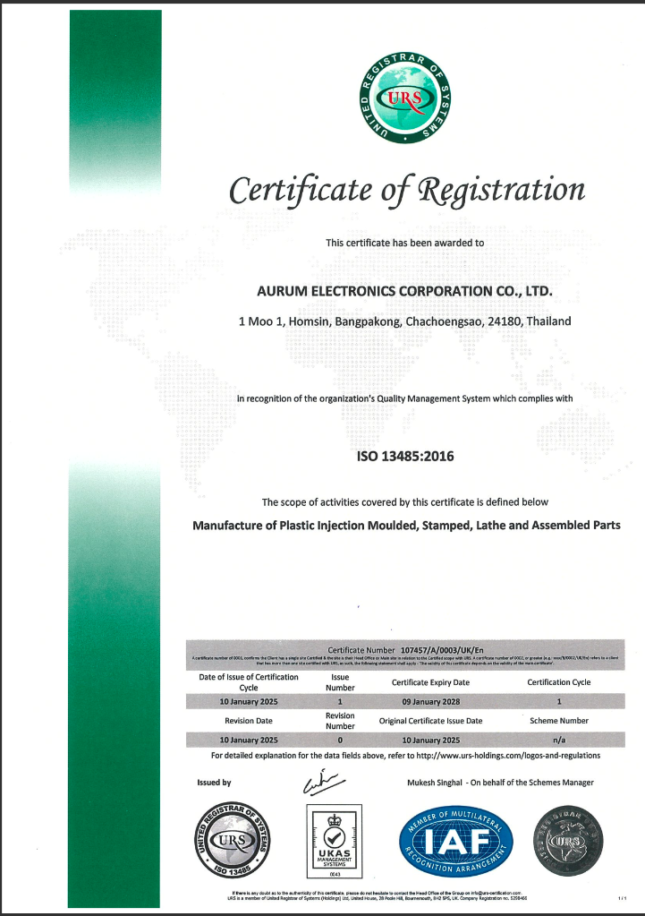
Quality System Certification
ISO 9001:2015
IATF 16949:2016
ISO 14001:2015
ISO 13485: 2016

Slide 7
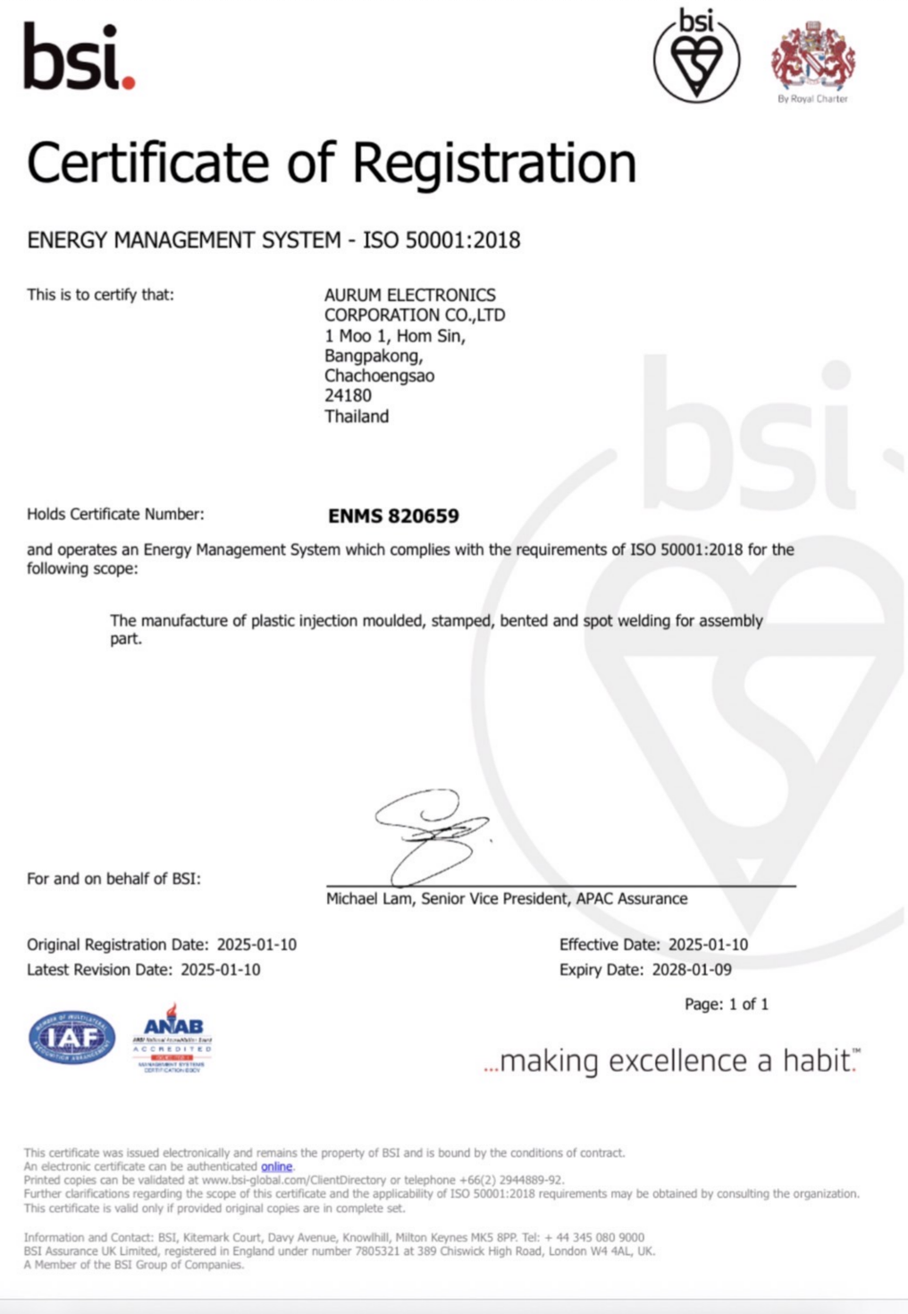


Quality System Certification
ISO 50001
ISO 14064-1
ISO 14067
For Certificate
about February 2026
For Certificate
about 2027

Slide 8


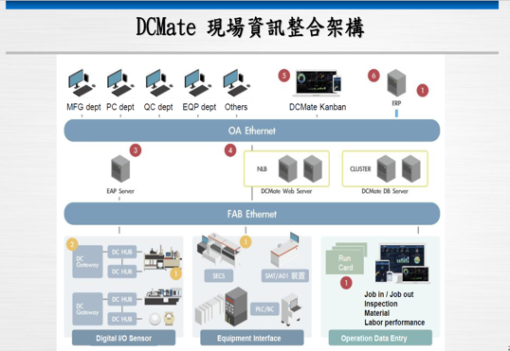
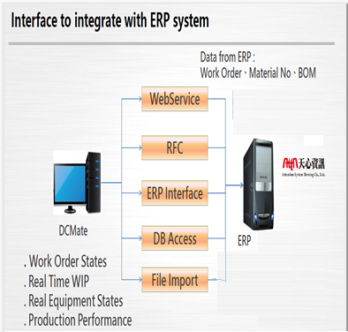
Internal Production Control System
ERP+ MES
🡪 2025

Slide 9
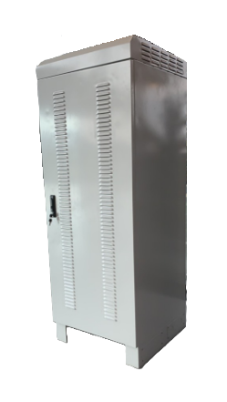
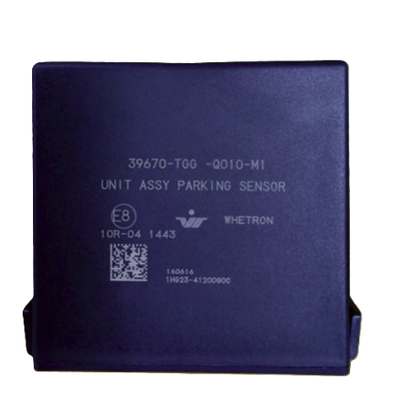
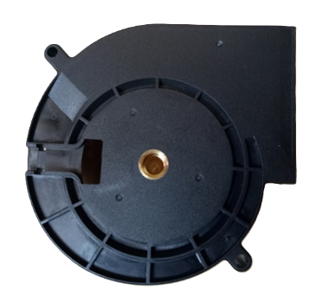
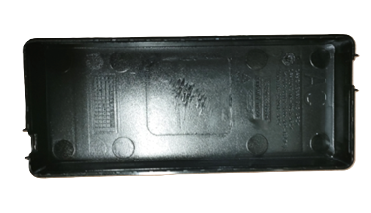
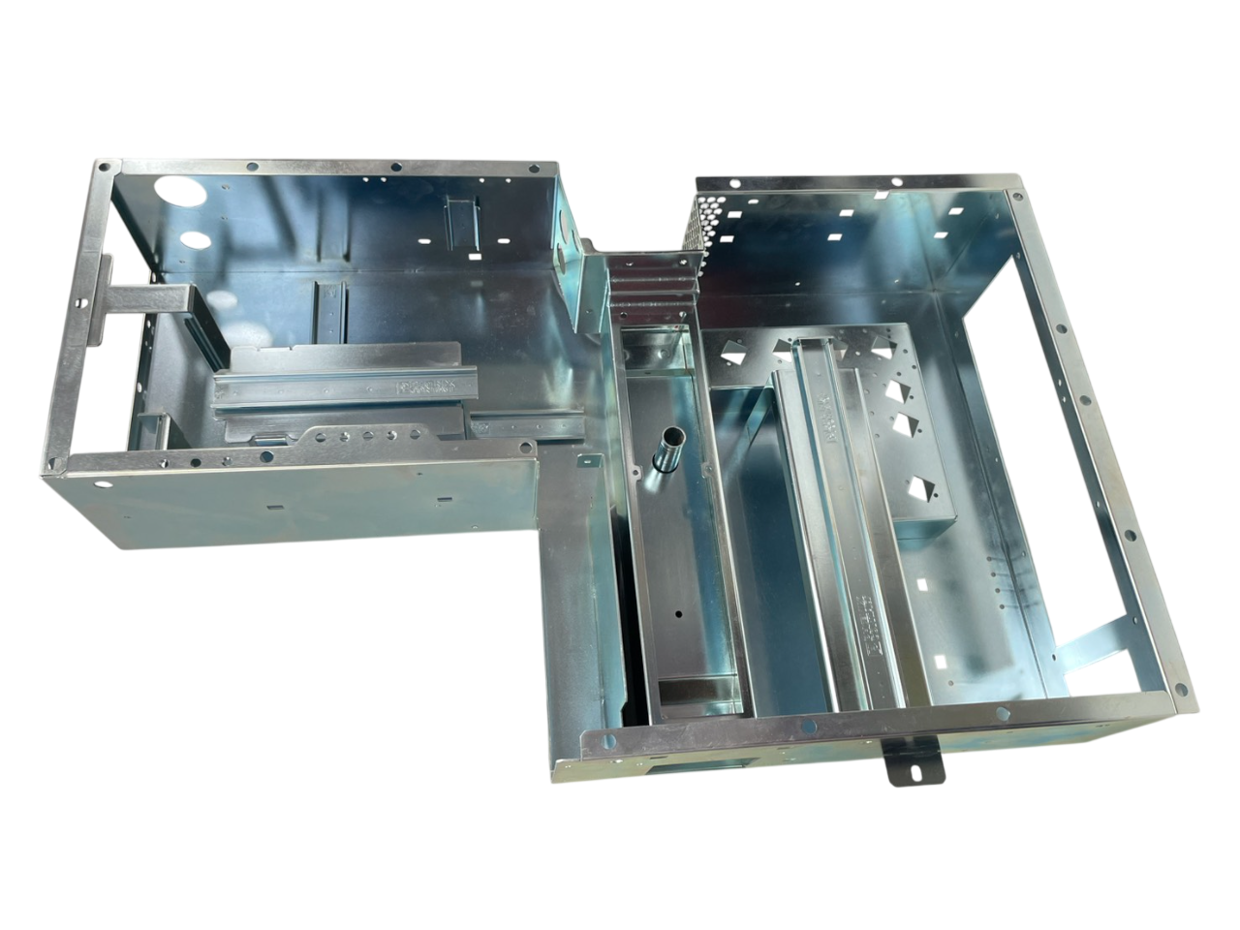
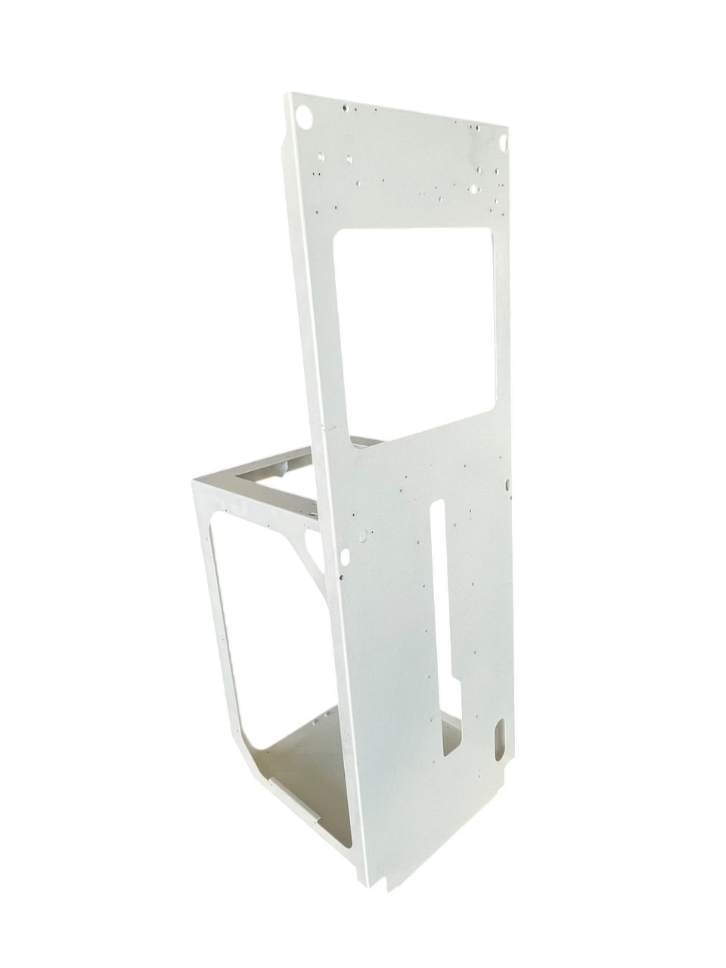
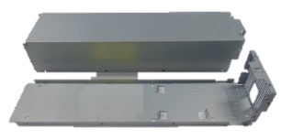
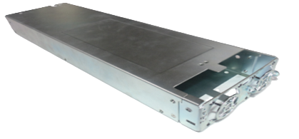
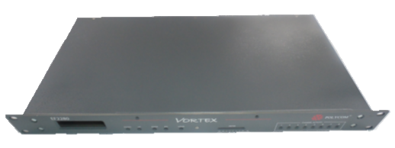
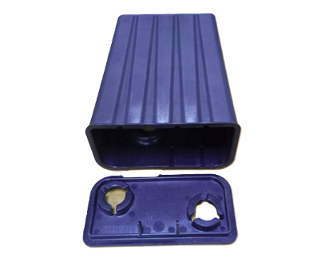
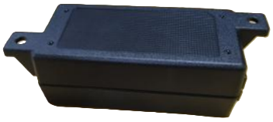
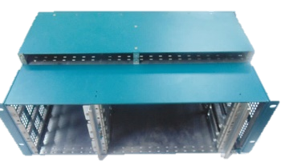
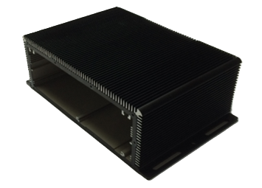
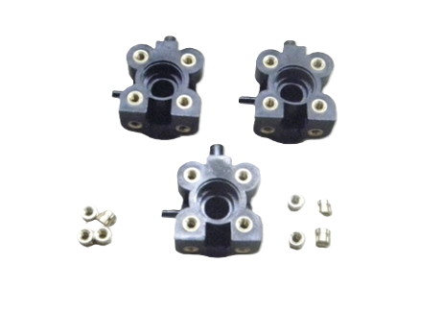
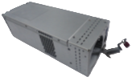
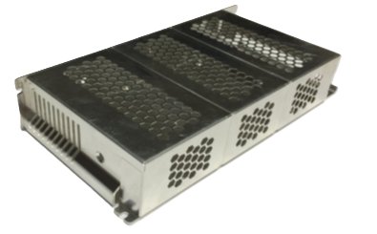
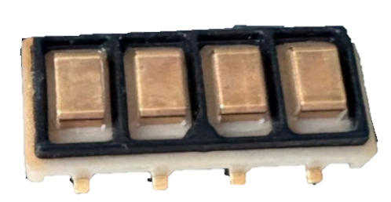
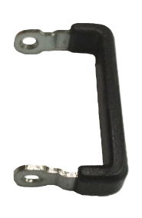

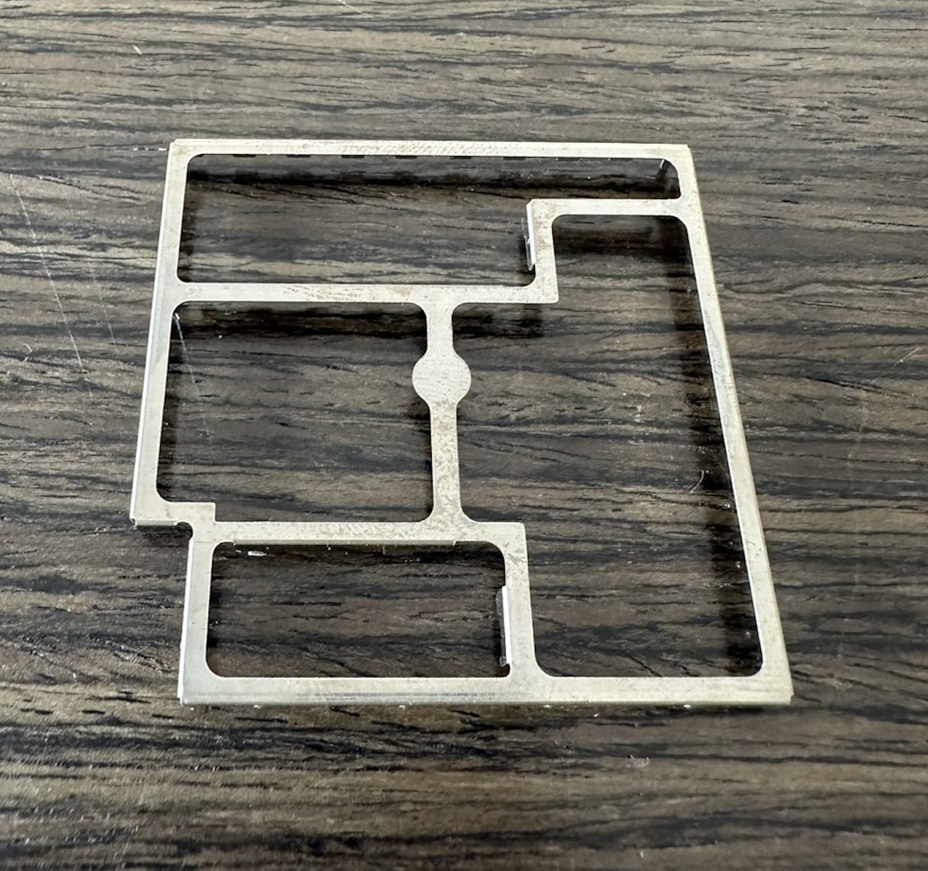


















Products
Power supply & Telecom | Semiconductor | Plastic
Busbar | Stamp parts | Electronic product assembly
Partnership with Acbel start from 2018

Slide 10




Mechanical Design Capability
Produce
Assembly
Research
Design
Customer
Request

Slide 11






Value Engineering Service
2D AUTOCAD
3D SOLIDWORKS
3D (SIMULATION)
SHEET WORKS
BENDCAM
ACTUAL FITTING

Slide 12







Soft tooling (NCT) Capability
Machines List
Tolerance Capability
Process Flow
Item | Machine | Capacity (Tons) | Model | Qty.
1 | Punching | 20 | VIPROS-255 | 1
2 | Punching | 20 | AC255NT | 2
3 | Punching | 20 | EM2510 MII | 1
4 | Laser | - | LC3015 F1 NT | 1
5 | Laser | - | ENSIS 3015 AJ FIBER LASER | 1
6 | Laser | - | LC-VALSTER-3015AJ G | 1
Process Type | Hole to Edge | Hole to Hole | Edge to Edge
Turret Punch | ± 0.1 | ± 0.1 | ± 0.1
Laser Cutting | ± 0.1 | ± 0.1 | ± 0.1
General Tol. DIN ISO 2768-mK
Common Material used
Aluminum (AL5052-H32, AL6061, AL1100)
Carbon Steel (SPCC, SS400, SPHC)
Galvanized Steel (SGCC, SECC, SPTE)
Stainless Steel (SUS301,SUS304,SUS430)
Copper (C1100-1/2H) & Brass (C2680)
Material thickness
Punching 🡺 0.5mm – 3.0mm
Laser 🡺 0.3mm – 9.0mm

Slide 13










Press Brake (Bending)
Machines List
Tolerance Capability
Item | Machine | Capacity (Tons) | Model | Qty.
1 | Bending | 35 | RG-35S DC9III | 2
2 | Bending | 80 | FBD8025 | 2
3 | Bending | 80 | RG-80 DC9III | 1
4 | Bending | 80 | HDS8025NT | 1
5 | Bending | 80 | HG-8025 | 1
6 | Bending | 100 | RG-100 | 1
7 | Bending | 143 | HDS1303NT | 1
Process Type | Internal Radius | Bend Angle | Bend to Edge
Bending | + 0.6 | ± 1 deg. | ± 0.2
General Tol. DIN ISO 2768-mK
** Capable to process up to Maximum Bending Length = 3,000mm

Slide 14




Hard Tooling (Stamping) Capability
Machines List
Tolerance Capability
Process Flow
Item | Capacity (Tons) | Model | Qty.
1 | 25 | - | 11
2 | 35 | TAKSIN PRESS | 32
3 | 45 | CHIN CHANG / CHIN FONG | 8
4 | 60 | SENSON | 16
5 | 80 | SENSON / TAKSIN PRESS | 24
6 | 110 | CHIN CHANG / SENSON | 19
7 | 160 | SENSON | 3
8 | 200 | SENSON | 2
9 | 250 | SENSON | 5
10 | 300 | SENSON | 2
11 | 400 | SENSON | 1
Process Type | Hole to edge | Hole to Hole | Internal Radius | Bend Angle | Bend to Edge | Edge to Edge
Stage Hard Tool | ± 0.05 | ± 0.05 | ± 0.05 | ± 0.5deg. | ± 0.05 | ± 0.05
Progressive Hard Tool | ± 0.05 | ± 0.05 | ± 0.05 | ± 0.5deg. | ± 0.05 | ± 0.05
General Tol. GBT 13914 / DIN ISO 2768-mK
Common Material used
Aluminum (AL5052-H32, AL6061, AL1100)
Carbon Steel (SPCC, SS400, SPHC, SK5)
Galvanized Steel (SGCC, SECC, SPTE)
Stainless Steel (SUS301,SUS304,SUS430)
Copper (C1100-1/2H) & Brass (C2680)
Material thickness
Stamping 🡺 0.2mm – 6.0mm

Slide 15
Soft tooling (NCT) Capability
Machines List
Tolerance Capability
Process Flow
Item | Machine | Capacity (Tons) | Model | Qty.
1 | Punching | 20 | VIPROS-255 | 1
2 | Punching | 20 | AC255NT | 2
3 | Punching | 20 | EM2510 MII | 1
4 | Laser | - | LC3015 F1 NT | 1
5 | Laser | - | ENSIS 3015 AJ FIBER LASER | 1
6 | Laser | - | LC-VALSTER-3015AJ G | 1
Process Type | Hole to Edge | Hole to Hole | Edge to Edge
Turret Punch | ± 0.1 | ± 0.1 | ± 0.1
Laser Cutting | ± 0.1 | ± 0.1 | ± 0.1
General Tol. DIN ISO 2768-mK
Common Material used
Aluminum (AL5052-H32, AL6061, AL1100)
Carbon Steel (SPCC, SS400, SPHC)
Galvanized Steel (SGCC, SECC, SPTE)
Stainless Steel (SUS301,SUS304,SUS430)
Copper (C1100-1/2H) & Brass (C2680)
Material thickness
Punching 🡺 0.5mm – 3.0mm
Laser 🡺 0.3mm – 9.0mm

Slide 16

Stamping Line
Item | Capacity (tons) | No. of Machines
1 | 25 | 11
2 | 35 | 32
3 | 45 | 8
4 | 60 | 16
5 | 80 | 24
6 | 110 | 19
7 | 160 | 3
8 | 200 | 2
9 | 250 | 5
10 | 300 | 2
11 | 400 | 1
 | Total | 123

Slide 17




Tool Room
NAME
QTY.
Horizontal Vertical Turret Milling Machine
5
Precision Surface Grinder
8
Engine Lathe
2
Engine Lathe Surface Grinding Machine
1
Wire Cut Machine
3
High Speed Small Hole Drilling EDM
1
Electrical Discharge Machine (EDM)
2

Slide 18








Machining
NAME
SPEED
TABLE SIZE (MM)
Mill Star
Litz
Litz
Litz
Max. 10,000 rpm
Max. 8,000 rpm
Max. 12,000 rpm
Max. 8,000 rpm
1100 x 600 x 650
450 x 300 x 300
550 x 400 x 500
450 x 300 x 300
CNC Milling
Miyano
Litz
Max. 6,000 rpm
Max. 8,000 rpm
Max 60 x 150
Max 200 x 400
CNC Turning
MODEL
SPECS
QTY.
Manual Lathe
Miyano
Litz
-
5 ~ 15mm
6 ~ 20 mm
4
10
2
Lathe Machine

Slide 19





3D Printing Capability
Printing Parameters
Compatible Materials
ABS/PLA/PETG/PET/TPU/PA/
ASA/PC/PLA-CF/PA-CF/PET-CF

Slide 20



Metal Joints
Type | Model | Qty.
Laser Welding | ALPHA LASER, 9kW, AL900F | 2
 | 2000W HANDHELD WELDING MACHINE, S&A CWFL-2000 | 1
TIG Welding | ARC MEN AC/DC, Digi-TIG320ACDC PLUS | 4
MIG Welding | MIGATRONIC, MIG445 MK III | 1
 | TURIN SMART ROBOT, 4.8kW, TKB1440E | 2
 | TURIN SMART ROBOT, 5.3kW, TKB1600E | 1
Spot Welding | ARC MEN AIR-PRESSURED SPOT WELDER, KE-35, 50KVA | 3
 | SHIHLIN DC SPOT WELDER, NF100-CN | 1
 | SUNCHEN MULTI HEAD SPOT WELDING MACHINE, 30M-1604P-2 | 1

Slide 21






Secondary Processes
Painting
1. Liquid Paint
2. Powder Coating - WAGNER
3. Auto Powder Coating – Dual WAGNER PEM X1 spray gun, WAGNER SPRINT 60L, CiP Engineering Automation
Buffing / Deburring Machine - AuDeBu1000 (Workpiece maximum size: 1000mm width, 20mm height)
Laser Marking – 3AXLE, TLS400-20W Laser System
Silk Screen
Curing Oven

Slide 22







Plating and Powder Coating
Powder Coating (Automated)
Plating
Central Plating Industry Co., Ltd. (CTP)
NAME
QTY.
NAME
QTY.
Barrel Plating System
1
Rack Plating System
1
Post Treatment
1
Baking
1

Slide 23











Quality Control Equipment
CMM
Height Gauge
Contour & Roughness
Smart scope
Romer ARM (753-SI)
Gloss Meter
Coating Thick. Gauge
Cross-cut
Color Meter
Caliper

Slide 24



Aurum Location
Aurum
Aurum – Suvarnabhumi Airport
Factory size: 54,400 sqm with 0.66MGW solar energy
Aurum – Laem Chabang Port

Slide 25
Q & A

